Slide 1
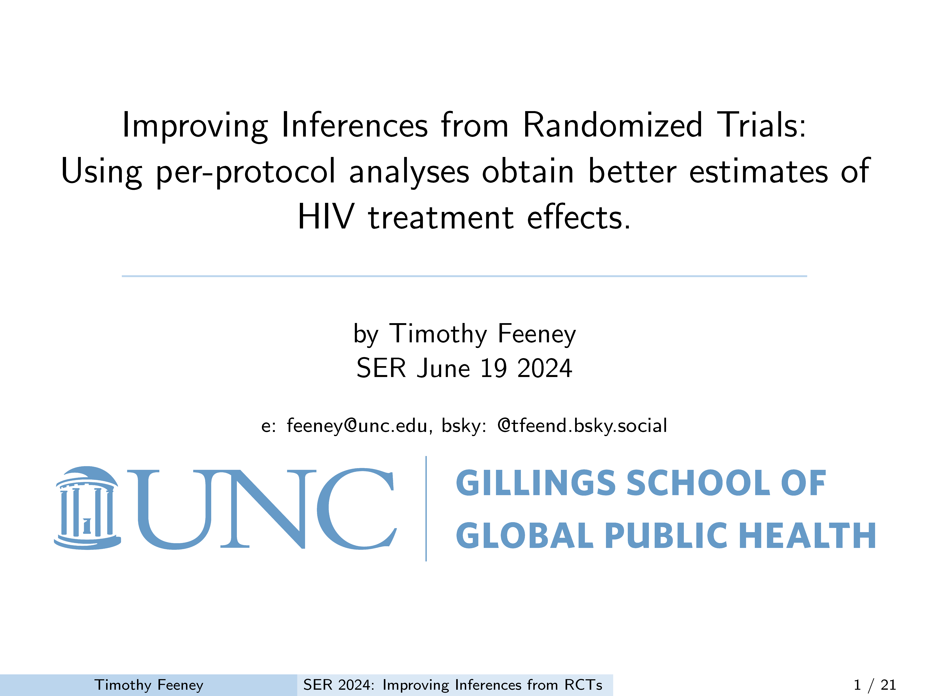

Slide 2
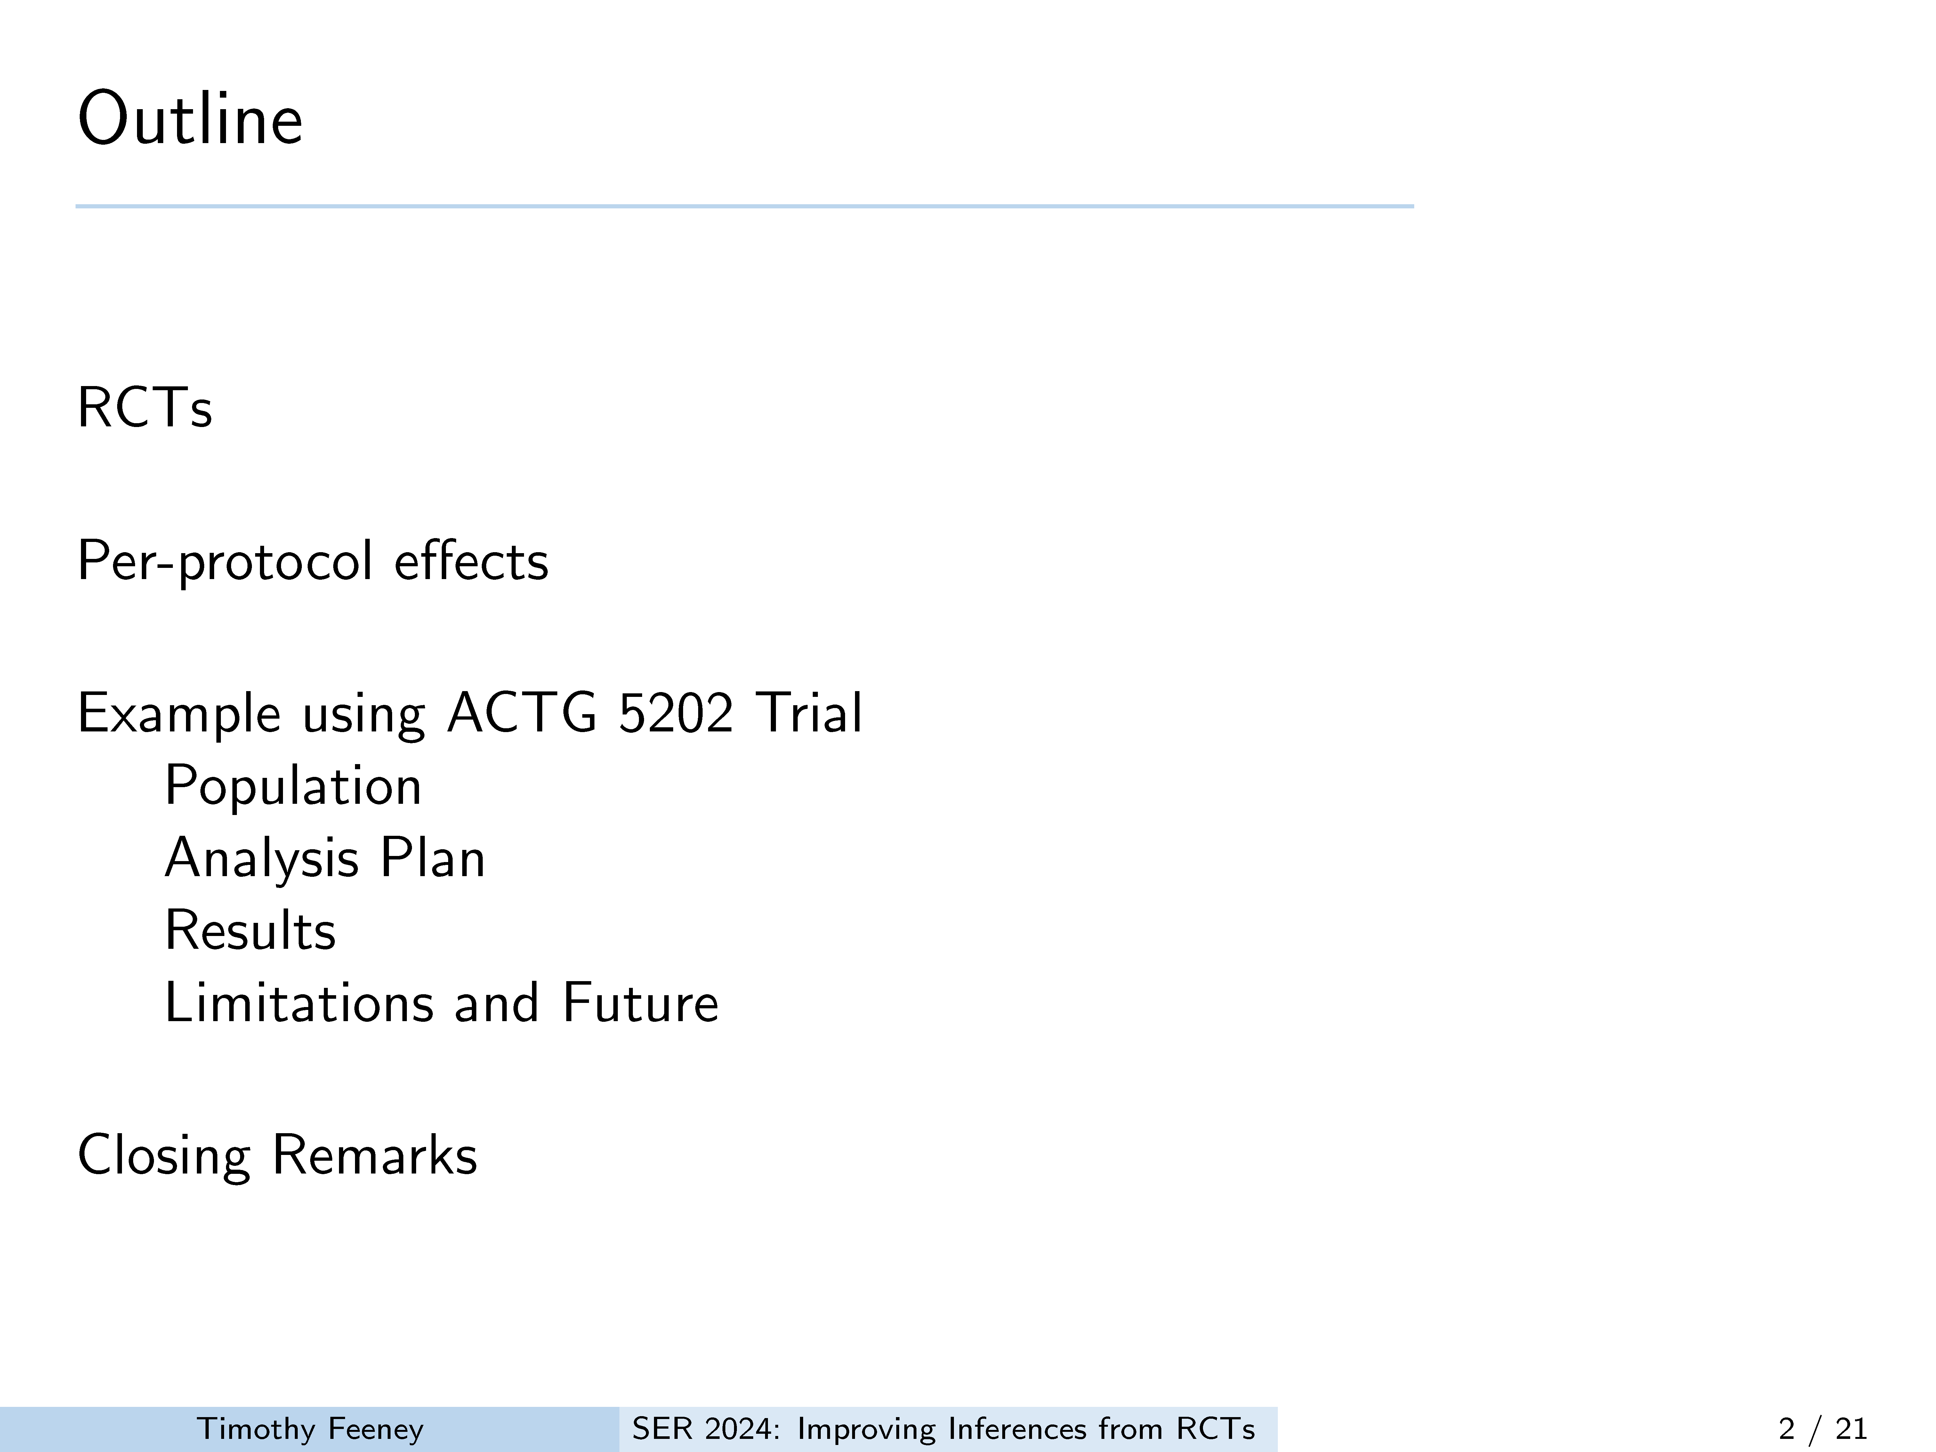
Notes:
Today I will be working with other presenters to both explain how per-
protocol analyses can facilitate better estimates and also convince you
that this is better than the status quo.
Ill start with background about RCTs, define per protocol effects, and then
finish up with an example.

Slide 3
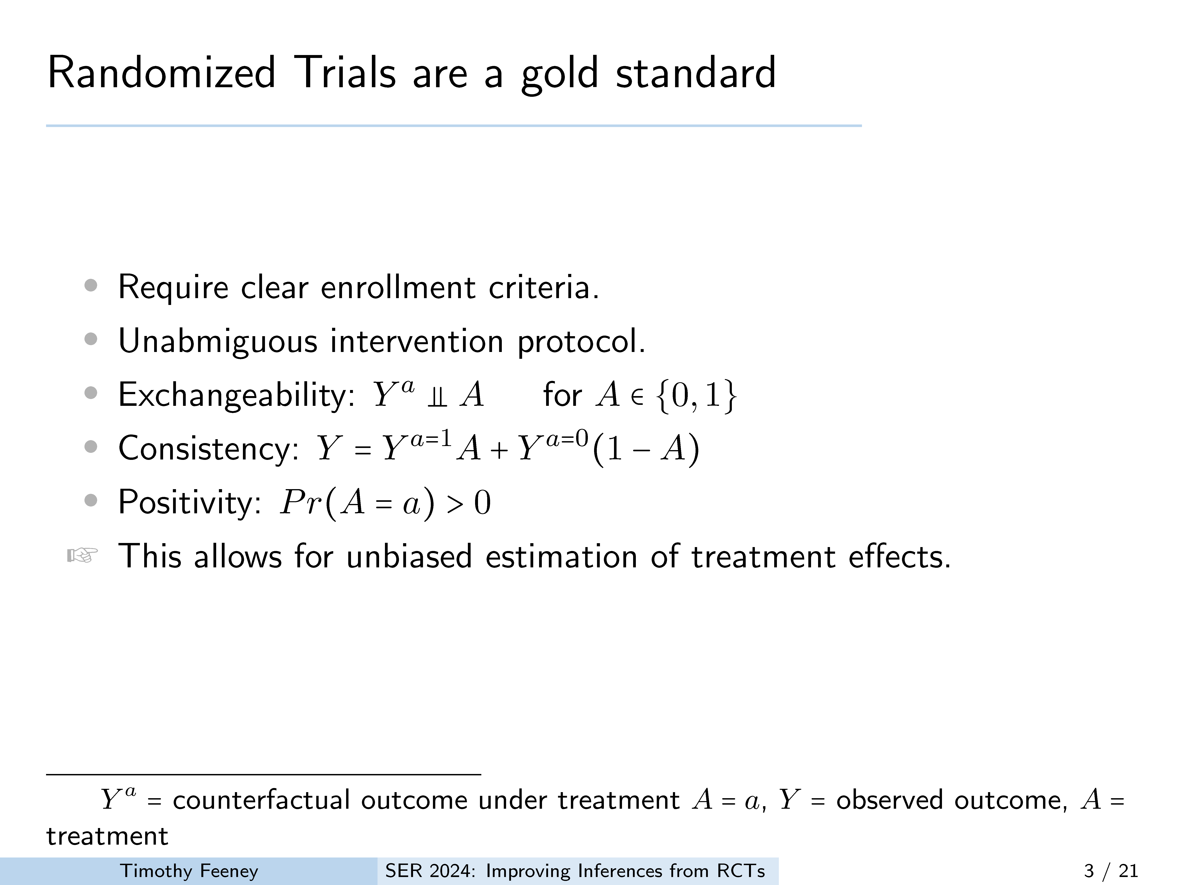
Notes:
RCTs are classically considered the gold standard in evaluating treatment effects. This status for RCTs originates in aspects that assure causal identification such as
clear enumeration of the population under study,
clearly laid out treatment protocols, and satisfying other
causal identification criteria of marginal exchangeability, causal consistency and positivity being met by design.

Slide 4
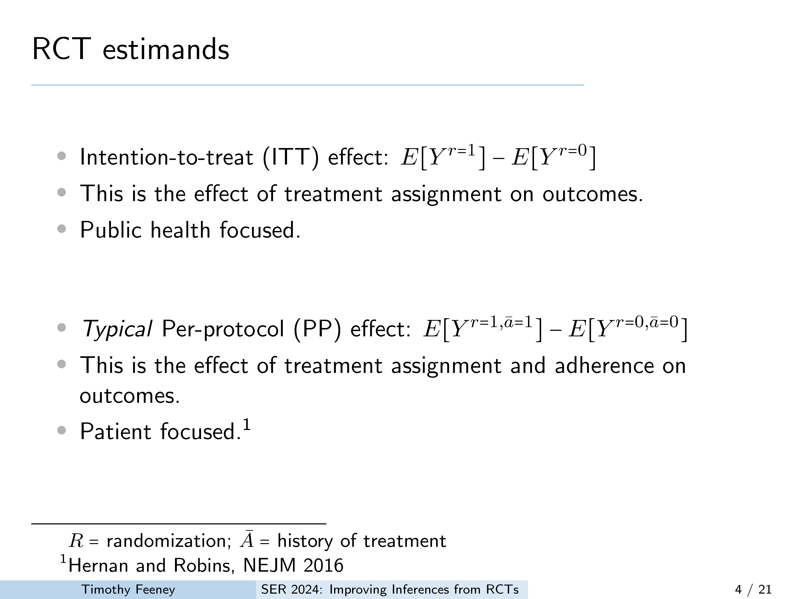
Notes:
• There are two commonly reported estimands in an RCT. The primary estimand reported is the intention-to-treat result, which presents the marginal effect of randomization to treatment. However, while this is public health focused, it is limited to evaluating the effect of randomization and not the effect of treatment.
• Instead, decision makers (e.g. physicians) and those on the receiving end of the treatment may want to know the effect if adherent to the treatment assigned. This cannot be answered with the ITT estimand and instead requires a per-protocol analysis that can take protocol deviation or loss to follow up into account.

Slide 5
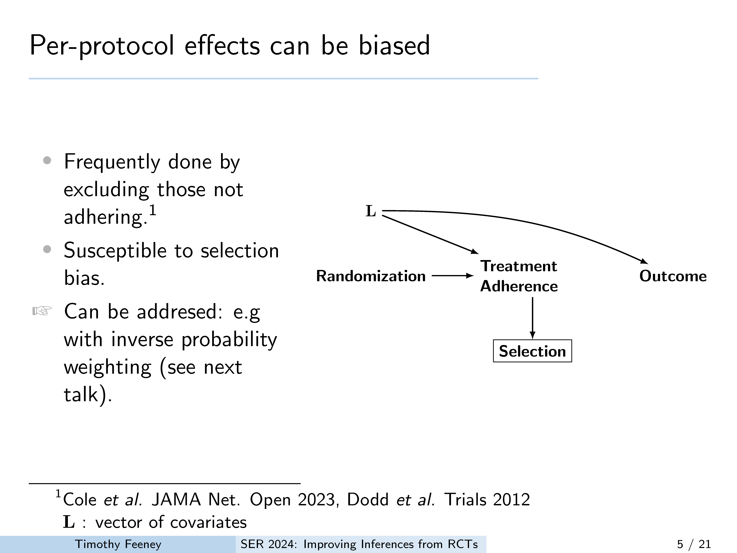
Notes:
While per protocol effects are attractive there is one main drawback, and that is that these estimates should be thought of more like analyzing an observational study where common causes of the outcome of interest and adherence should be accounted for–this was formalized in 2000 by Robins and Finkelstein, and analyses accounting for adherence have been well described, at least in the specialist literature.
• Nevertheless, per protocol effects are typically estimated by excluding those that deviate from the protocol and as a resulting per protocol estimates can be biased.
• This simple DAG illustrates the problem. If per protocol analyses are done where only those who adhere are included you create a selection bias by conditioning on a selection node which is downstream of a collider, the treatment adherence node.
There are ways around this, though, that I will touch on and will be addressed in more detail in the next talk.

Slide 6
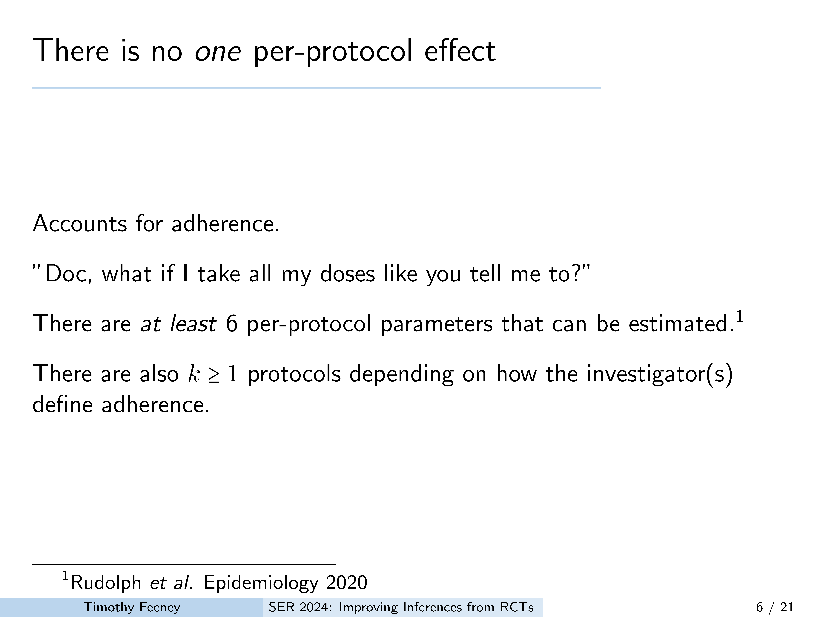
Notes:
While Per Protocol effect estimation is appealing because it can estimate treatment effects while accounting for adherence. It is important to note that there is no ONE per protocol effect and there are at least 6 estimands that can be considered per protocol effects.
• In fact, these estimands can be made even more precise to account for deviating from 1 to many doses–more on this in a bit. This, in effect, creates many more protocols for consideration based on how the investigator defines protocol adherence

Slide 7
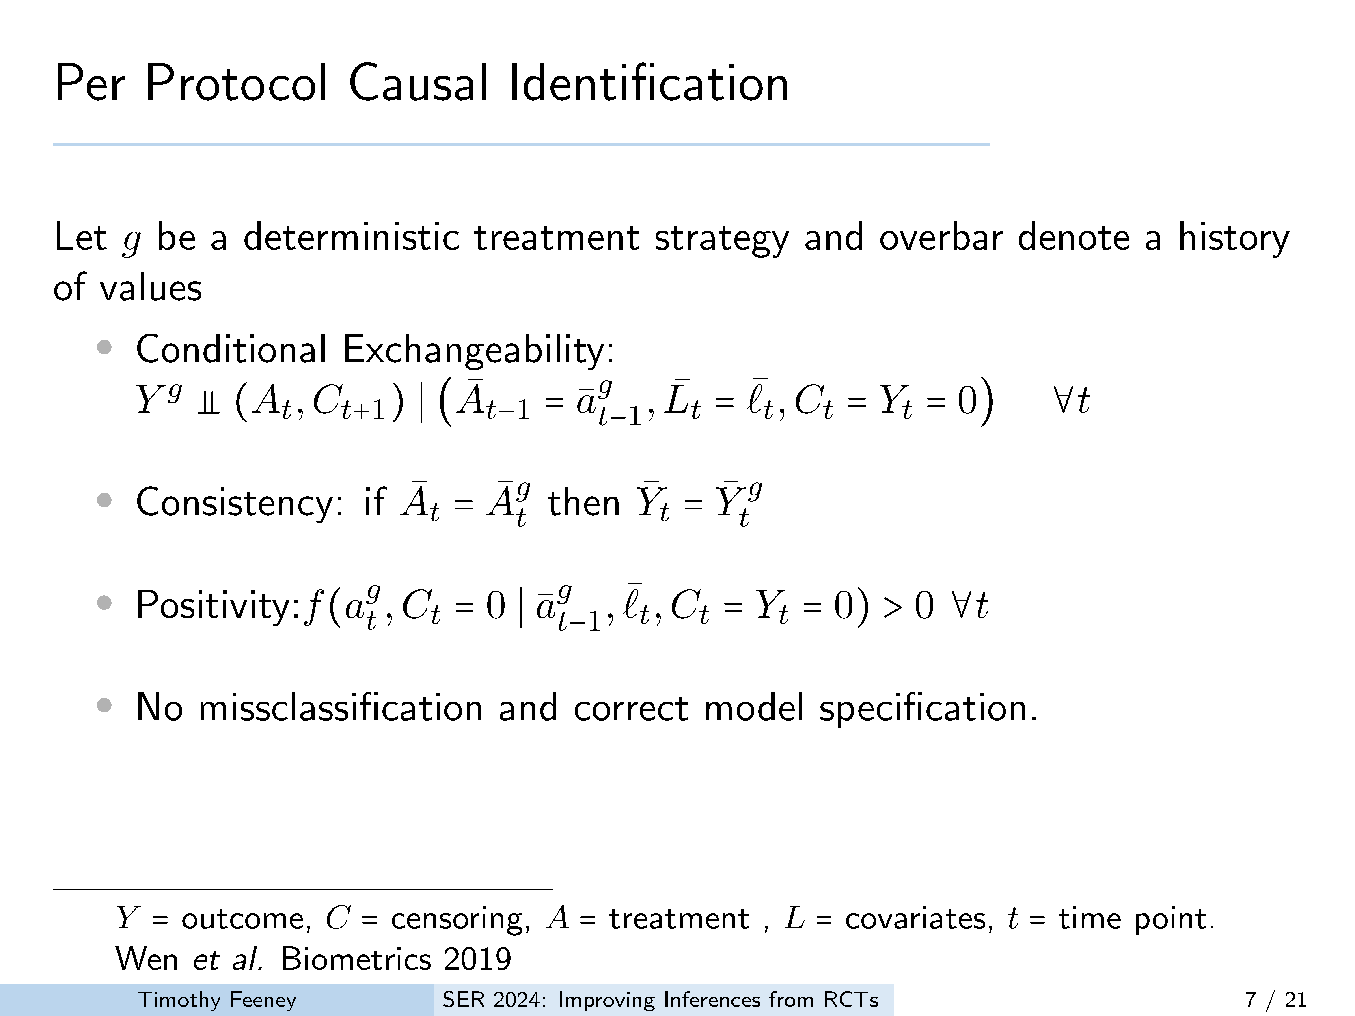
Notes:
Before we go further it is useful to briefly cover the causal identification criteria, which are slightly modified to account for the treatment regimens described by the trial protocol. This allows for us to be explicit about identification over time and in the presence of censoring. Here we consider these conditions under g, a deterministic treatment strategy like treat everyone at all time points versus not. Generally, the identification conditions are now updated for each time point.
For instance, We now assume that both treatment and censoring is independent of an individuals counterfactual outcome conditional on adherence under a specific treatment regimen at all prior times, and covariate values at all time points
Further Consistency and positivity are also required at each time point.
And last, as usual, we must assume no missclassification or model misspecification

Slide 8
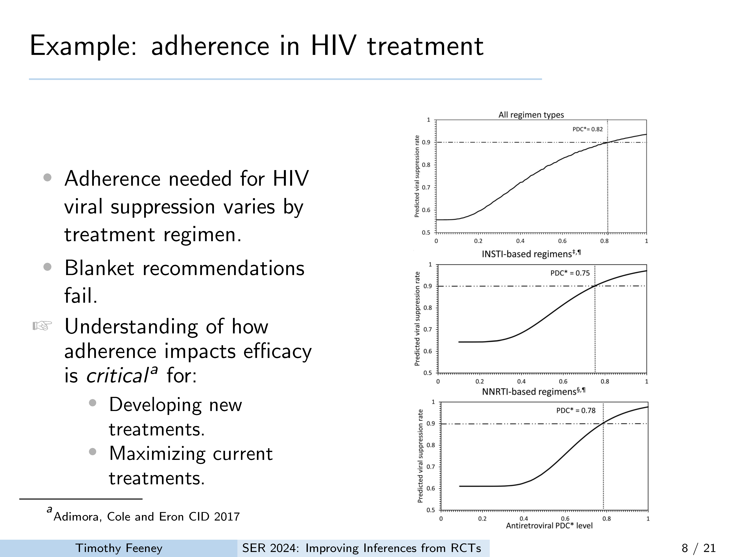
Notes:
Ill now use the previous concepts, and cover some results from a per protocol analysis that varies how adherence to the protocol is defined in order to illustrate my point. The motivation behind this analysis is that the efficacy of HIV treatments depends both on the mechanism of the medication and the adherence to a dosing scheme.
In general, it is not possible to make a blanket statement that any number of missed doses per time-frame is ok or not in HIV treatment. Here illustrated by differing percentage of days covered to achieve viral suppression based on medication regimen. Thus, evaluating adherence in in terms of doses taken should be considered. This is where a per-protocol analysis comes in.

Slide 9
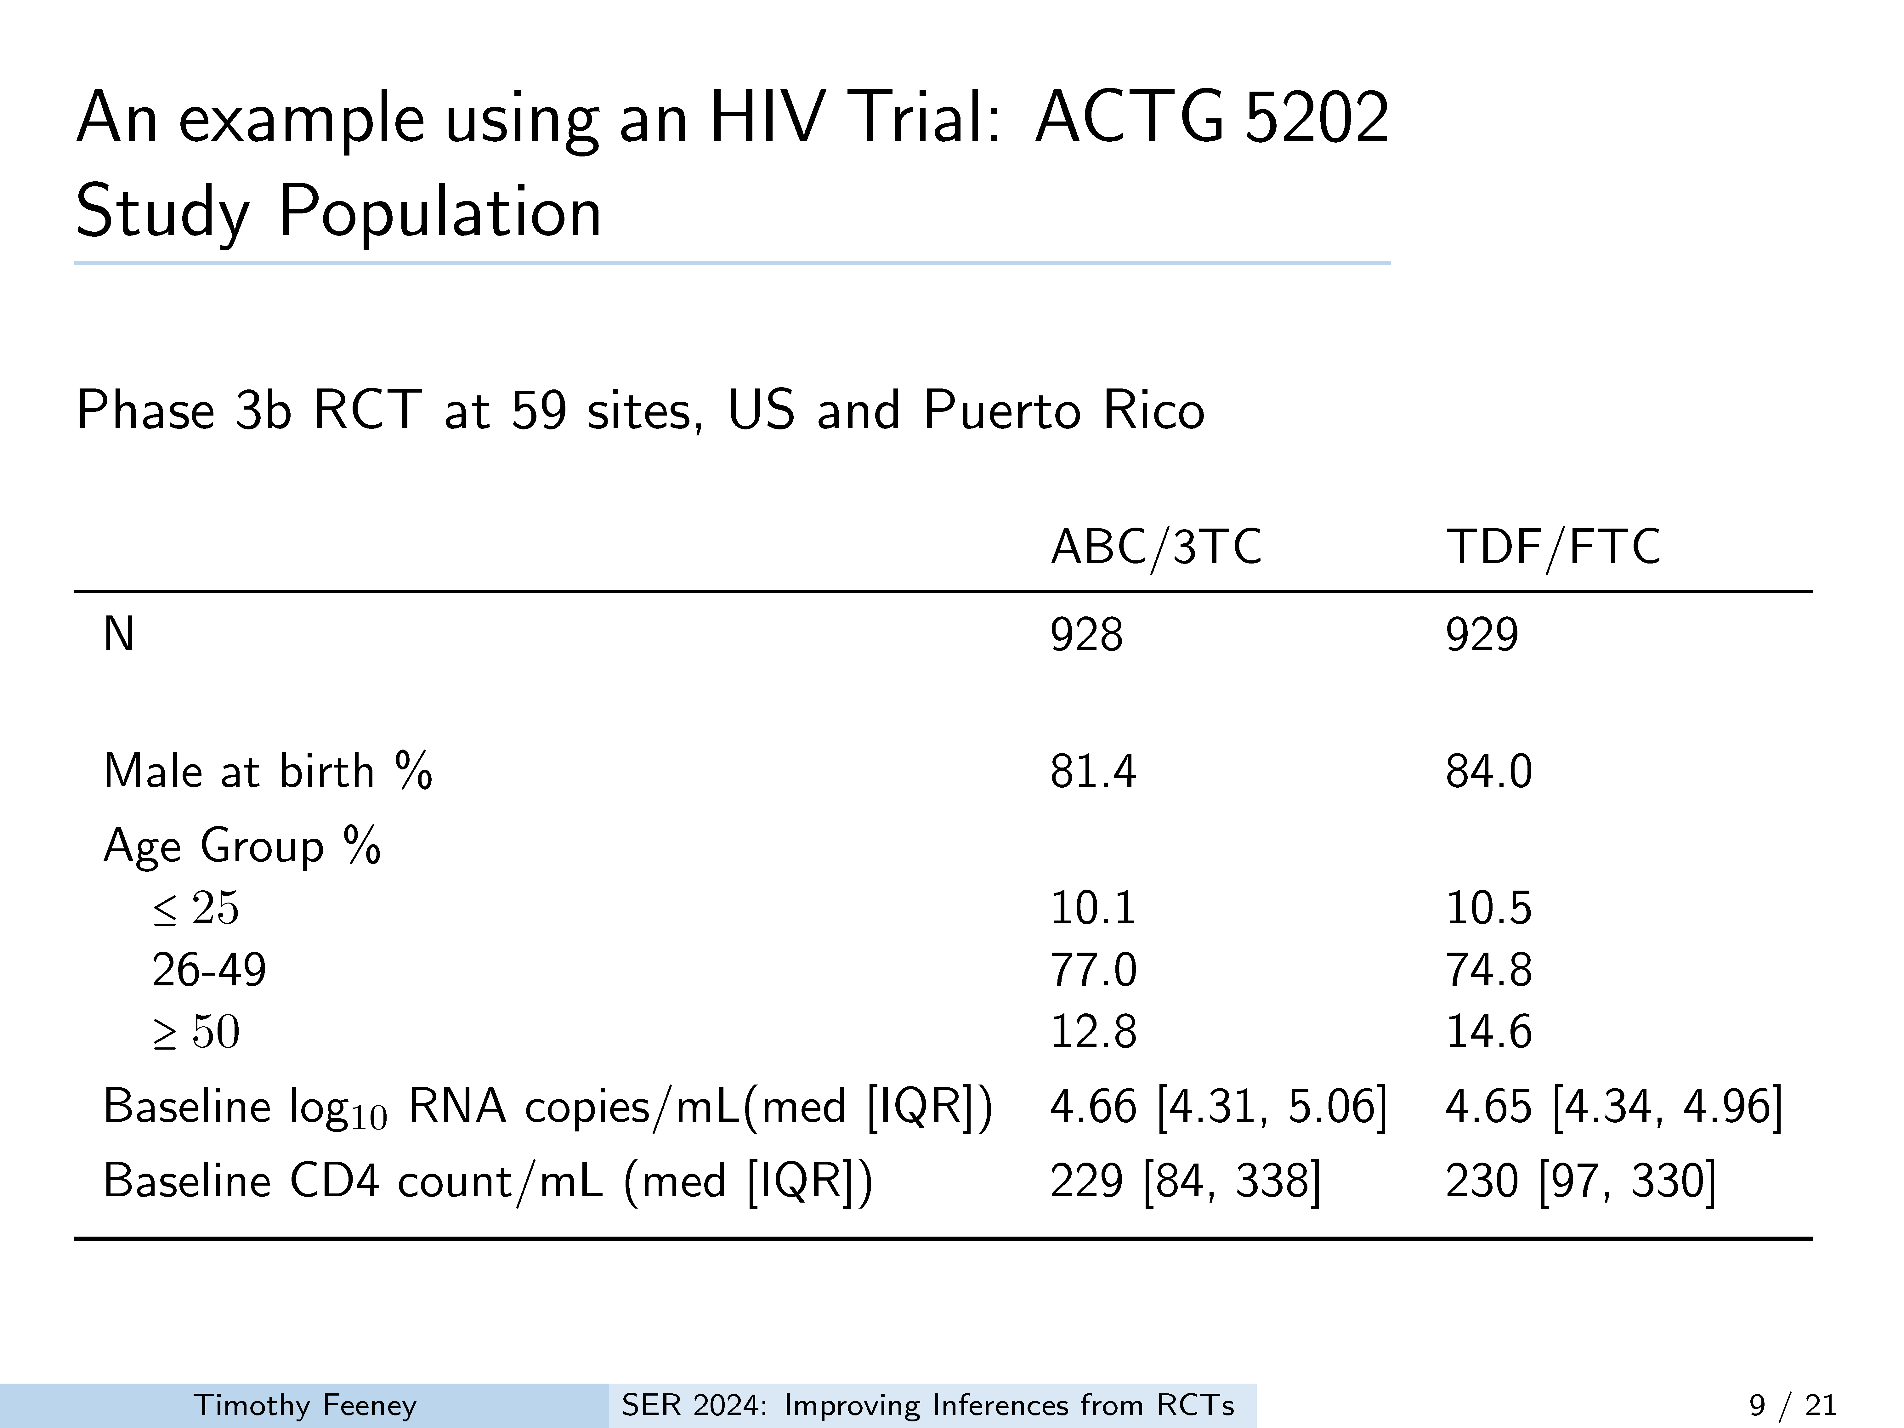
Notes:
Our example study was the ACTG 5202. This was a Phase 3 RCT conducted at 59 sites in the US and Puerto Rico. The study Randomized 1857 persons 1:1 TDF/FTC or ABC/3TC stratified by HIV-RNA screening level and it was published in 2009 and 2011.
It is worth it to note a few points about this population
• Most participants were male, and between 26 and 49 years old and starting with a relatively high viral load and low CD4 count.

Slide 10
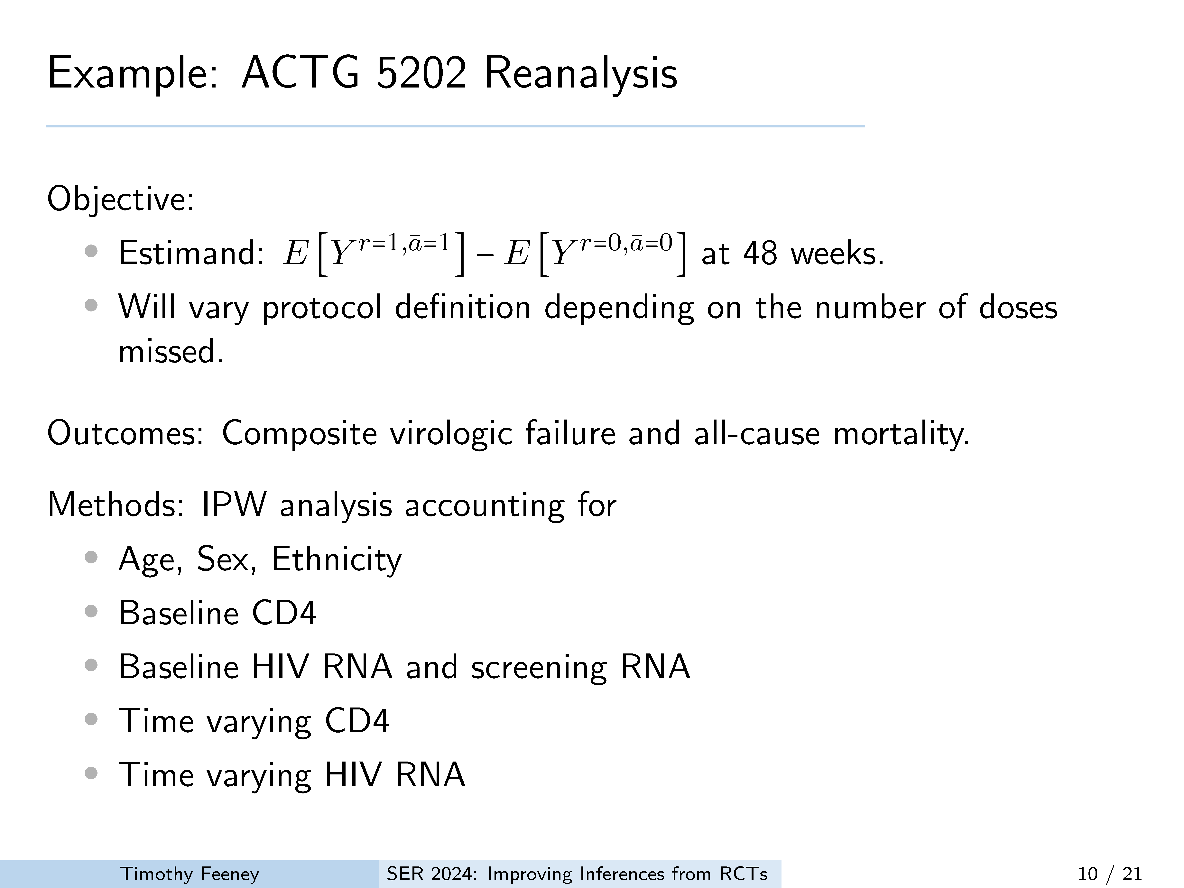
Notes:
In our reanalysis we aimed to estimate the per protocol effect on a composite of viral failure and all cause mortality at 48 weeks but under different definitions of the treatment protocol based on missed doses.
We performed an IPW analysis while accounting for baseline demographics and biochemical markers, and we also accounted for time varying HIV RNA and CD4 count.

Slide 11
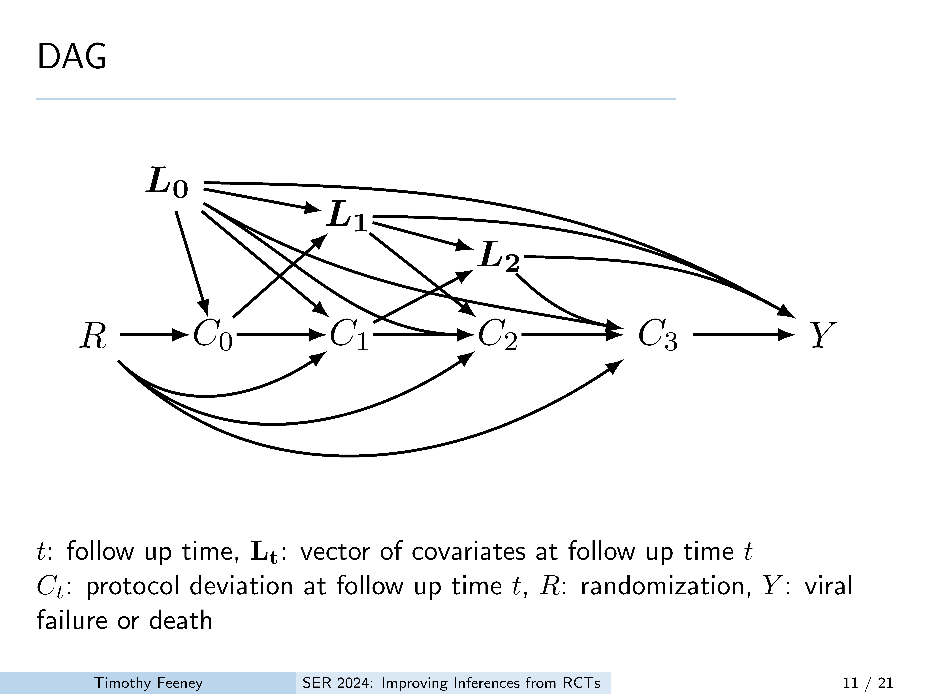
Notes:
This simplified DAG illustrates the assumptions for our reanalysis. Briefly, we are assuming that randomization to treatment impacts adherence (C) through treatment assignment, and that adherence at each time point (C) is only impacted by treatment assignment,
adherence at the previous time point,
and the baseline and the immediately preceeding values of covariates (L)

Slide 12
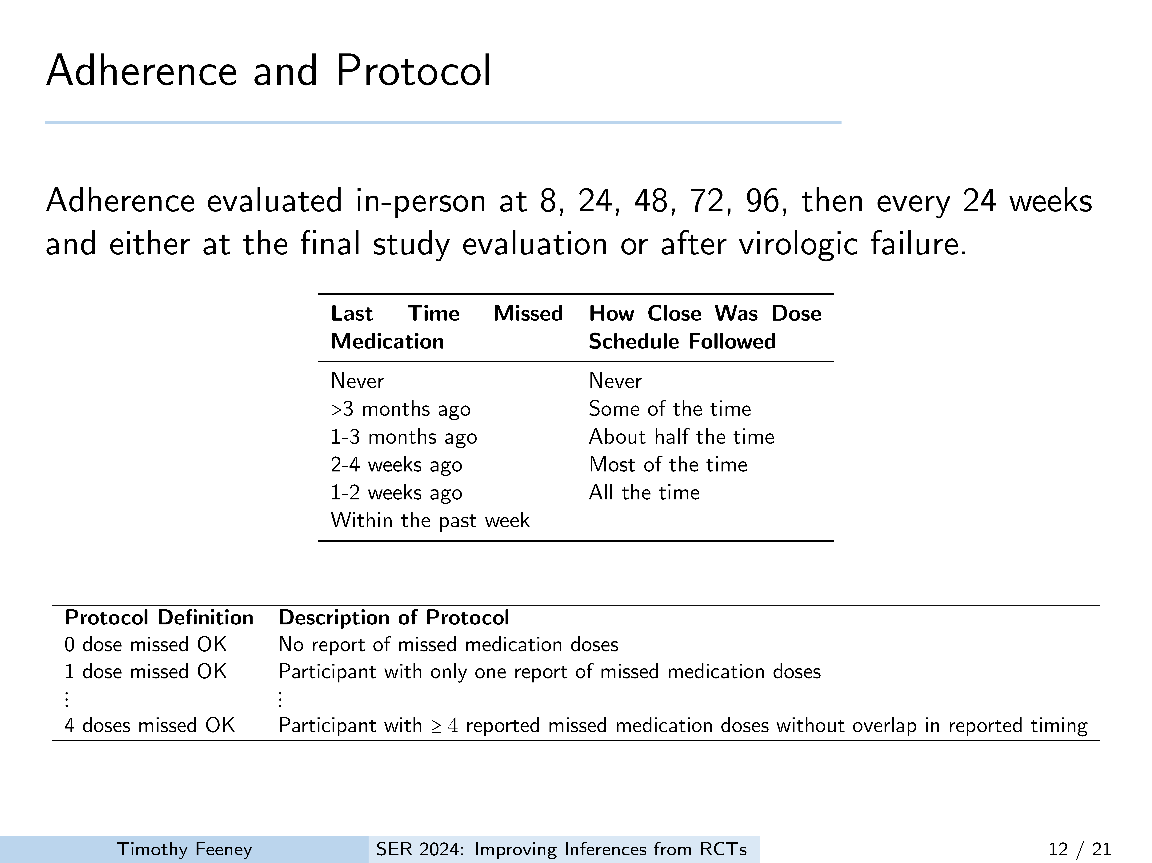
Notes:
Because we are interested in accounting for missed doses we needed information on medication adherence. Adhrence in ACTG 5202 was collected using self report and whether there were missed doses reported within the previous time frame. For instance, asking whether the participant missed any dose between visits. There was also information about how closesly the dosing regimen was followed but we didnt incorporate that here
We defined protocol deviation, illustrated in the bottom table, by how many missed doses were acceptable. For instance if 0 doses missed were OK, then as soon as a person reported missing any doses they were censored. For those where missing 4 doses was ok, as soon as they missed the fifth dose they were censored.

Slide 13
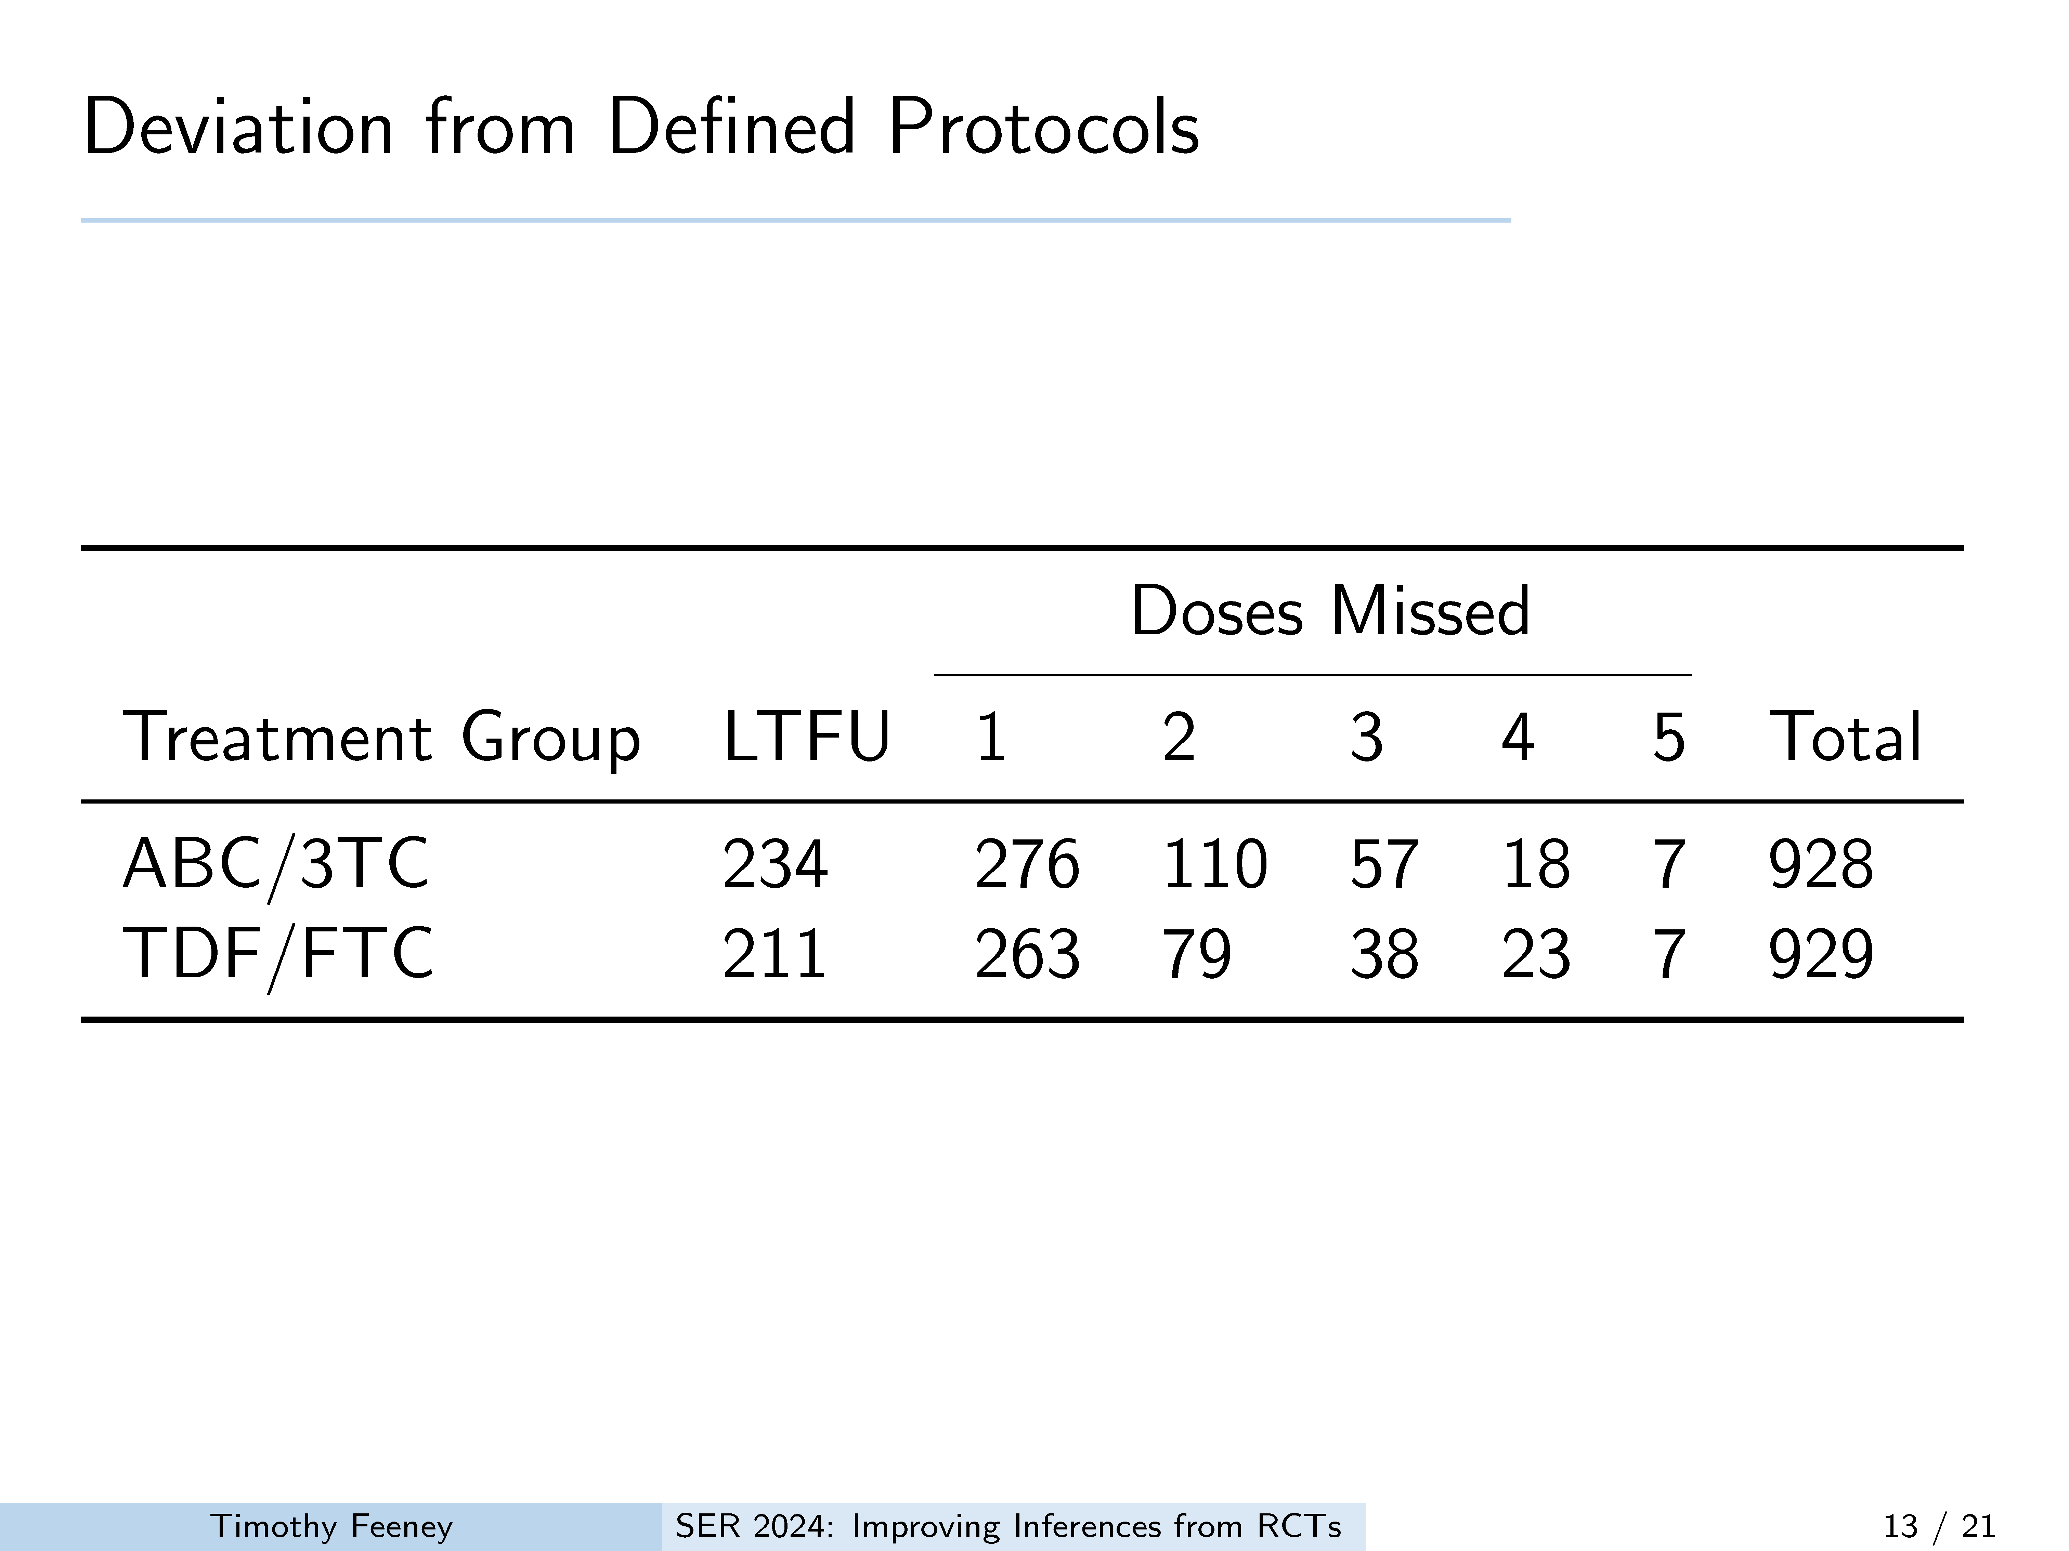
Notes:
Here are the number both lost to follow up and missing doses. As might be expected as the definition of protocol deviation by becomes more relaxed, by allowing more missed doses before censoring, there is a decrease in the number of participants deviating from the protocol. Because fewer and fewer participants have missed 4,5,6 etc doses.
In the first column are those that were lost to follow up. These are censored without missing a dose. In column one are the number that were censored in the analysis due to missing one dose.
Column two then shows the number that were censored due to missing two doses; these include some from the first column as well, as a subset of those missing one dose ultimately missed a subsequent dose.

Slide 14
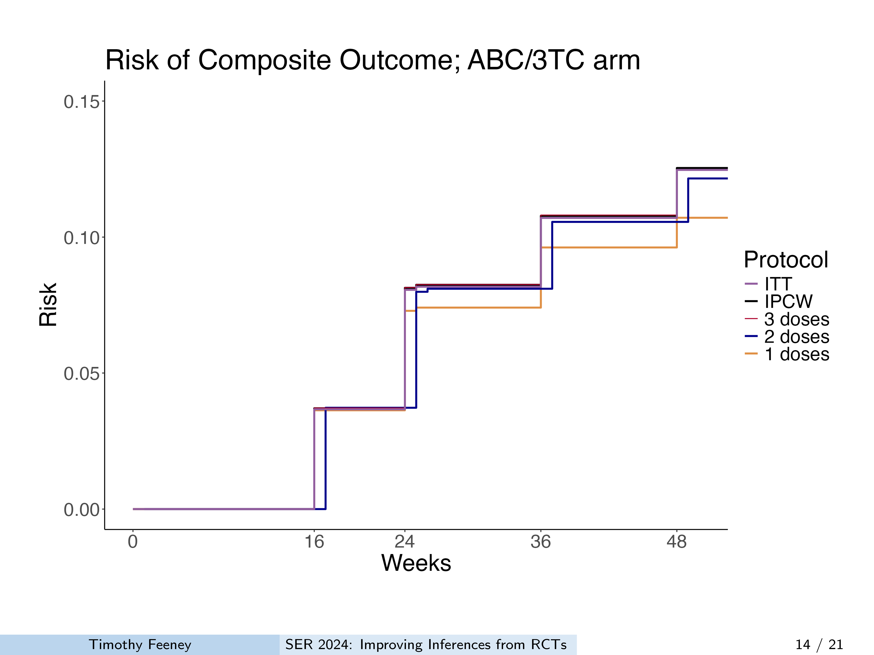
Notes:
This figure shows the results for the weighted analysis for the risk of the composite outcome. Here we see only the ABC/3TC arm.
What i hope you notice is that There is overlap of the ITT, IPCW , 2 and three dose protocol estimates. However, the 1 dose estimate, in orange, indicates a slightly lower risk in the ABC/3TC arm once accounting for 1 missed dose, suggesting those at higher risk of the outcome are missing one dose.

Slide 15
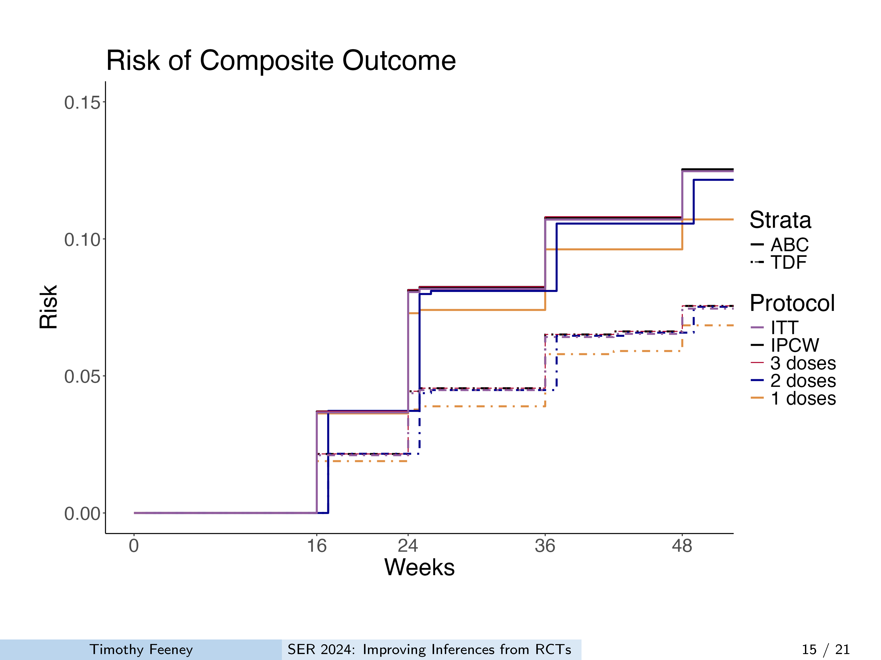
Notes:
When we add in the TDF/FTC arm you can see a similar pattern to the ABC/3TC arm where the risk of the composite outcome is lower in the protocol where we censor individuals after one dose, again this is the orange line.
Note that the drop in risk in the 1 dose protocol appears greater in the ABC arm compared to the TDF arm, which has implications for the risk difference.

Slide 16
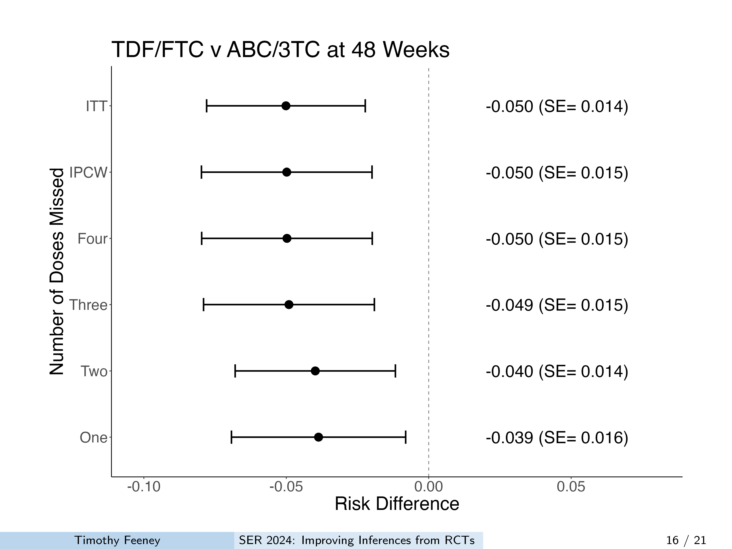
Notes:
Here are the estimated risk differences and robust standard errors at 48 weeks . In the protocol where censoring occurred after 1-2 doses we can see the risk difference is not as extreme as in the estimates in the ITT, IPCW, and 3 and 4 dose protocols.
These results suggest that the true effect of TDF vs ABC is weaker than suggested in the ITT analysis. This appears to be the result of higher risk persons being more likely to miss at least one dose and more in the ABC arm. It is also possible this result stems from covariates which are not included.

Slide 17
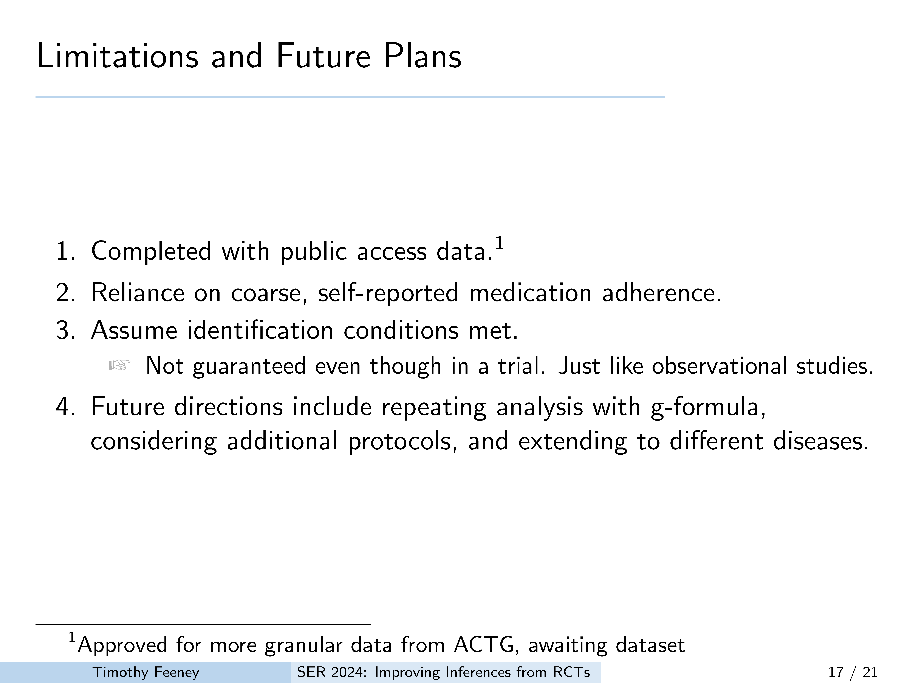
Notes:
This is a work in progress and There were some limitations. this analysis was completed with public data and as a result some covariates are categorized or not present. 2) Currently this analysis relied on coarse data on adherence and I am currently working to improved estimates of the number of doses that people actually missed. 3) we assume that we have met all the required identification conditions based on covariates in the IPW models. As mentioned, It is very possible we have not included all necessary covariates
Our next steps are to consider additional granular data once the ACTG provides us with an updated data set, complete this analysis using the g-formula, transport these results to the US population of HIV + individuals, and identify additional disease processes where deviation from treatment may be important for effect estimation.

Slide 18
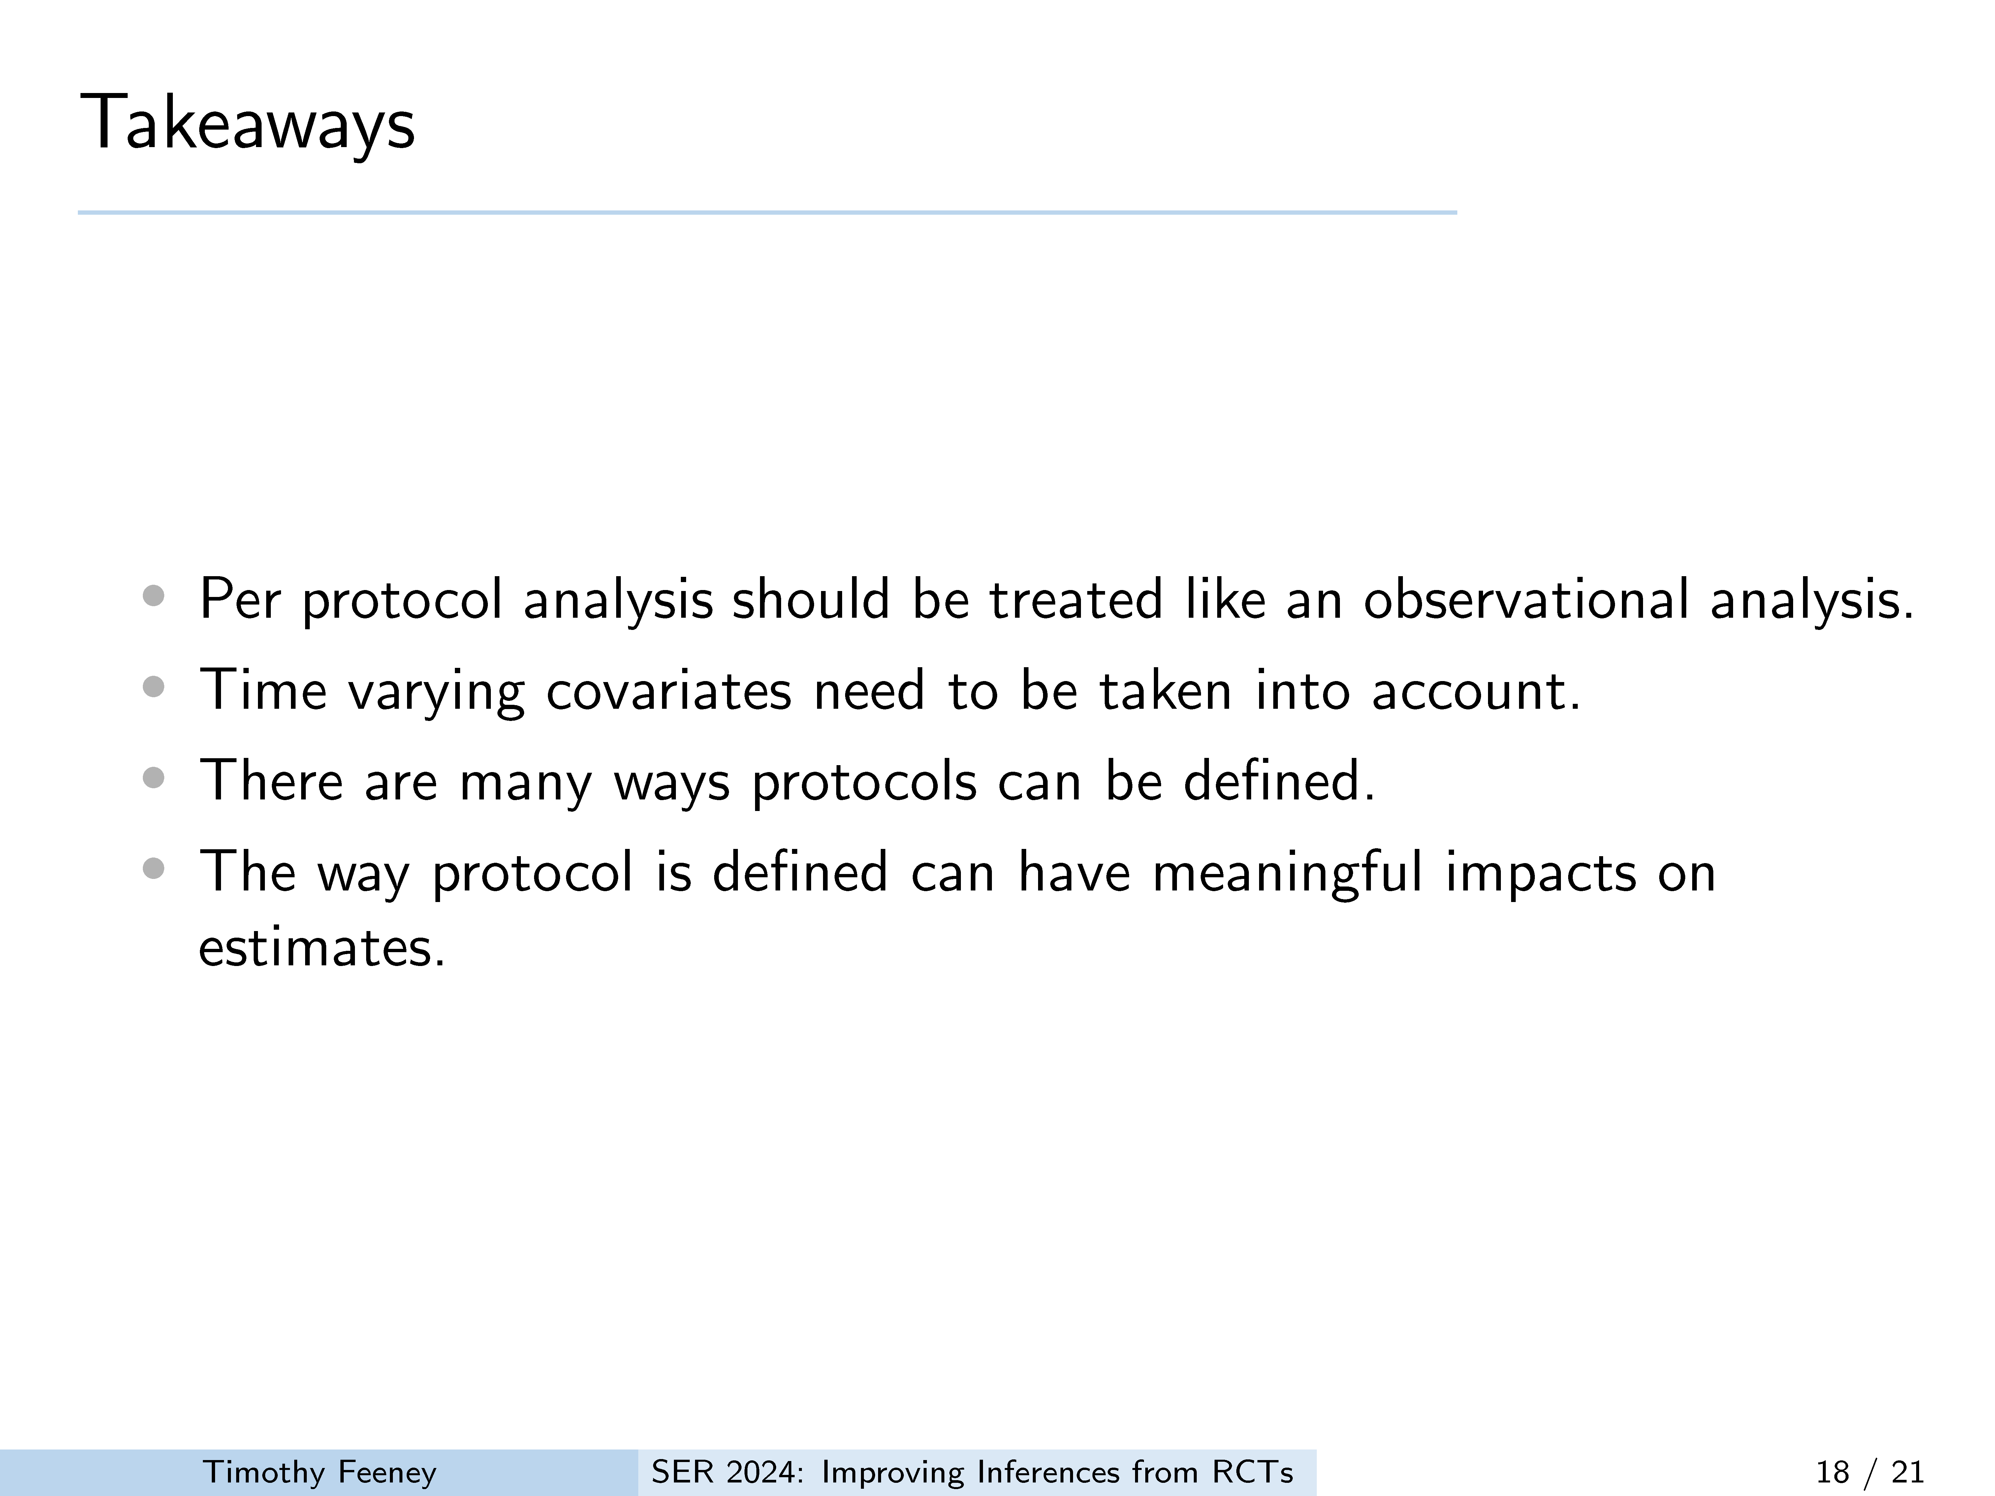
Notes:
In closing i hope the 4 mains take aways from this are
Per protocol effects are important and similar to observational analysis
AND
”Protocol” can be define in many ways and incorporated into the analysis to get better effect estimates while accounting for adherence.

Slide 19

Notes:
Thank you for your time. Id like to acknowledge Steve Cole, the cole
lab, Paul Zivich, Catherine Li and all the participants of the ACTG 5202
study without which this work would not be possible.

Slide 20
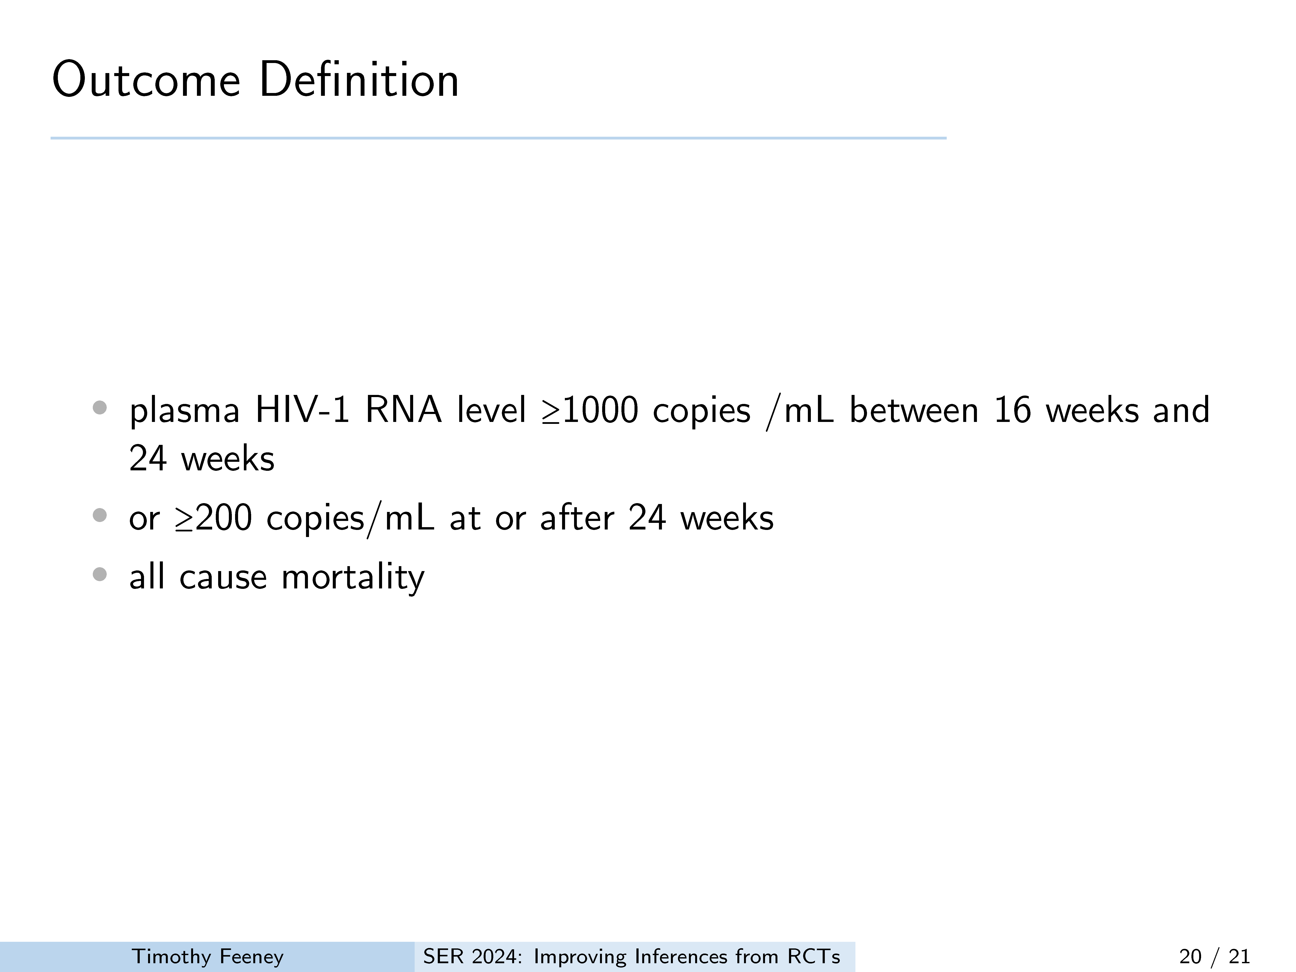

Slide 21
